Slide 1


Fall 2021 Switch Enrollment
Pre-Medicare
Effective January 1, 2022
Doug Crandall, President
Therese Saunders, Vice President
Leanne Larranaga-Ruffy, Secretary
David Archuleta, Executive Director
Notes:
Welcome to the New Mexico Retiree Health Care Authority’s fall 2021 Switch Enrollment Pre-Medicare presentation. This presentation covers NMRHCA’s Pre-Medicare benefits that become effective January 1, 2022.

Slide 2
Agenda
Agency Background Information
  NMRHCA’s Mission and Strategic Goals
  Program Budget and Finance
  Trust Fund Balances
  Fund Solvency and GASB Reports
2022 Pre-Medicare Monthly Premiums
2021 - 2022 Program Updates
Helpful Reminders
Notes:
During this presentation, I will review some Agency Background Information, share the 2022 Pre-Medicare Monthly Premiums, discuss program updates for 2022, and share helpful reminders.

Slide 3
Mission and Strategic Goals
Mission
Maintain comprehensive and affordable health insurance benefits for public retirees and eligible dependents
Strategic Goals
Fiduciary Responsibility
  Extend the solvency of the fund and protect the program
  Steward trust-fund contributions and investment earnings
  Avoid deficit spending for as long as is practicable
Customer Service
  Improve communication with stakeholders
  Educate plan participants about the program
  Deliver Wellness Programs to improve our member’s quality of life
Administration
  Procure and administer the program in a cost-effective manner
  Identify programs and services helpful to member and agency goals
  Provide comprehensive services and access to care
Notes:
Our mission is to ensure NMRHCA maintains comprehensive and affordable heath insurance benefits for participating retirees, spouses, and eligible dependents.
Our goals fall into 3 categories:
Fiduciary Responsibilities –- for example the board of directors is responsible for balancing the revenues received with the value of benefits provided to members. This goal seeks to provide value to existing members, while ensuring benefits for future plan participants.
2. Customer service – answering calls, responding to inquiries and researching members concerns
3. Program Administration – procuring benefits, administering the program, and making sure the bills are paid.
These goals help our program to achieve its overall purpose.

Slide 4
Budget and Finance
FY22 Operating Budget
Healthcare Benefits Administration
Uses:
  Benefits - $360.1 million
    ACA Fees - $44 thousand
    Agency Operations- $3.3 million
Sources:
  EE/ER Contributions - $114.6 million
  Retiree Contributions - $175 million
  Tax & Rev Suspense Fund - $36.8 million
  Misc. Revenue - $30 million
  Interest - $400 thousand
Program Support (26 FTE)
Salaries & Benefits - $2.1 million
Contractual Services - $621 thousand
Other Costs - $548.6 thousand
Finance
NMRHCA Trust Fund
Investments held by State Investment Council NMRHCA charged pro rata portion of investment fees
Asset Allocation performed biennially
  NEPC – 2014 & 2016
  Wilshire – 2018 & 2020
Investment Performance as of June 30, 2021
  1-year return: 25.08 percent
  3-year return: 10.15 percent
  5-year return: 10.59 percent
  10-year return: 7.99 percent
Liquid investments held by State Treasurers Office to pay daily, weekly, and monthly claims and operating expenses
Notes:
The Fiscal Year 2022 Operating Budget shows information about Healthcare Benefits Administration (Uses and Sources) and Program Support cost.
The Finance section details NMRHCA Trust Fund investments, biannually reviewed asset allocation, and investment performance as of June 30, 2021.
Liquid investments are those held by the State Treasurer’s Office to pay daily, weekly, and monthly claims and operating expenses.

Slide 5
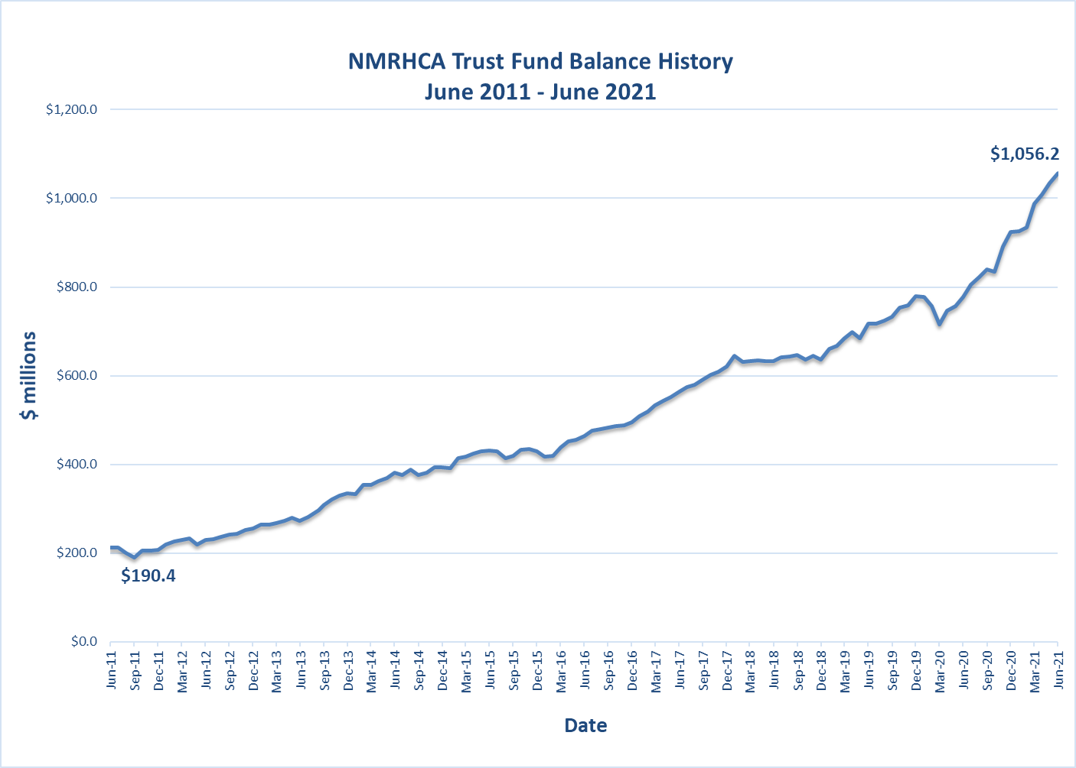
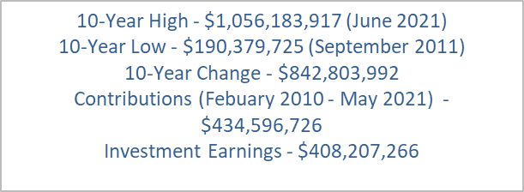
Investments
Notes:
NMRHCA Trust Fund Balance History shows a 10 year snapshot of growth from June 2011 – June 2021.
During this period of time, the agency has contributed more than $434 million toward the trust fund to ensure the preservation of the benefits for future plan participants.
The trust fund has also generated investments earning approaching an average 8 percent return over the last 10 years, adding more than $408 million over this time period.

Slide 6
Solvency & Government Accounting Standards Board
Solvency Study
Performed annually
Used for strategic planning purposes
30-year projection of cash inflows and outflows
  Plan design i.e., copays, deductibles, and coinsurance
  Subsidy levels
  Network/medical and prescription drug access
2020 Results
  2026 Projected year of deficit spending –expenditures exceed revenues $5.4 million
  <2050 – Projected year of insolvency (beyond 30 years)
2021 Results
  2027 Projected year of deficit spending –expenditures exceed revenues $3.4 million
  <2050 – Projected year of insolvency (beyond 30 years)
GAS 74
Completed November 4, 2020
As of June 30, 2019
  Total OPEB Liability - $3.9 billion
  Fiduciary Net Position - $756.7 million
  Net OPEB Liability - $3.2 billion
  Funded ratio – 18.92%
As of June 30, 2020
  Total OPEB Liability - $5 billion
  Fiduciary Net Position - $829.7 million
  Net OPEB Liability - $4.2 billion
  Funded ratio – 16.50%
As of June 30, 2021 – Pending
GAS 75
Applies to employer groups i.e., State of New Mexico, Cities, Counties and Municipalities
Similar to pension requirements w/regard to reporting of liabilities by group
Notes:
The Solvency Study, based on a 30-year projection of cash inflows and outflows, is performed annually and is used for strategic planning purposes.
The 2020 Solvency Study’s results show that the fund will remain solvent beyond 2050, when the trust fund balances are completely exhausted. The 2021 Solvency Study also shows that the fund will remain solvent beyond 2050.
A required Government Accounting Standards 74 report was completed November 4, 2020, showing total liability, fiduciary net position, funded ratio for June 30, 2019 and 2020. GAS 75 applies to employer groups and similar to pension requirements with regard to reporting of liabilities by group.

Slide 7
Pre-Medicare Monthly Premiums
(examples based on maximum subsidy)
Rate Increase - 6%
Laws 2021, Chapter 136 – No Behavioral Health Cost Sharing
  Eliminates cost-sharing (deductibles, coinsurance and copayments) for behavioral health services including inpatient hospitalizations, partial hospitalizations, residential treatment, detoxification, treatment of substance abuse use disorder, intensive outpatient therapy, outpatient treatment and all medications.
  Effective January 1, 2022 through December 31, 2026
Notes:
Effective January 1, 2022, there will be a rate increase of 6% on the Pre-Medicare plans. The example provided in this slide is based on a person who receives the maximum possible subsidy. The rate increase will be reflected in your switch enrollment packet and the full rate sheet can be found on our website www.nmrhca.org. There will be no plan changes in 2021 for our Pre-Medicare plans. Please call NMRHCA if you need to update your address or need switch enrollment information.
A change to New Mexico Law this year eliminates cost-sharing (deductibles, coinsurance and copayments) for behavioral health services including inpatient hospitalizations, partial hospitalizations, residential treatment detoxification, treatment of substance abuse use disorder, intensive outpatient therapy, outpatient treatment and all medications. This means that patients will not pay any co-pays out of pocket for these services. This law remains in effect from January 1, 2022 through December 31, 2026.
Please call NMRHCA if you have had a change in address or need information regarding switch enrollment.

Slide 8
2022 Program Updates
Hinge Health – Blue Cross Blue Shield Value and Premier Plans
  Digital musculoskeletal (MSK) for back and joint pain
  Sensor technology w/clinical team to provide health coaching and anytime access
Delta Dental PPO Point-of-service Network
  Enhanced coverage
RFP for Pharmacy Benefit Management Services – October 2021
  Effective July 1, 2022
RFP for Life Insurance - Fall 2022
  Effective July 1, 2023
2022 Legislative Session
  Special/Supplemental Appropriation Request
Notes:
Updates to expect beginning January 1, 2022
Blue Cross Blue Shield and Premier Plans will start implementing Digital Musculoskeletal also known as MSK for back and joint pain and Sensor technology with a clinical team to provide health coaching and anytime access
Delta Dental has enhanced their coverage when it comes to point of service.
In the month of October of 2021 there will be a Request for Proposal to find the best Pharmacy Benefit Management Services - any changes will be effective 07/01/2022
In Fall 2022 there will be a request for proposal for the life insurance- if there are any changes they will be effective 07/01/2023
2022 Legislative session NMRHCA will interduce a supplemental appropriation request

Slide 9
Helpful Reminders
Please verify your coverages
If you are not changing plans, you do not need to submit a Change Request Form
Turning 65 or becoming Medicare Eligible in 2022?
  Separate notice of Medicare options will be sent 2 months prior to turning age 65
Fall 2021 Switch Enrollment Only
  Change plans or coverage levels
Fall 2022 Open Enrollment
  Enroll in medical coverage
Moving/change of address - please contact our office to let us know!
Notes:
You will be receiving a switch enrollment packet in the mail, if there has been a change of address for physical and mailing or you just need to verify what we have on file. Contact our office to verify or make a change to your mailing address.
When you receive your switch enrollment packet, please pay attention to your current benefit premiums and compare them to the future benefit premiums. If you are not making any changes, you do not need to return the switch enrollment for, you may keep it for your records.
For Retirees, spouses, and dependents that are eligible for Medicare will receive a Medicare Switch enrollment packet 60 days before their birthday month.
If you need to add medical coverage for you, your spouse, or eligible dependent you need to wait until Open Enrollment. Open enrollment occurs every odd year in the month of January. The next open enrollment is January 1, 2023 – January 31, 2023.

Slide 10
If you have questions or want more information:
Call us toll free: 1-800-233-2576
8:00AM – 5:00PM (Monday through Friday)
Or visit us at: www.nmrhca.org or
www.facebook.com/nmrhca
Office Hours by Appointment Only
Notes:
We are open Monday through Friday from 8 am to 5 pm, please contact NMRHCA if you have question’s or need additional information. You can call us toll free 1 800 233 2576, visit our website www.nmrhca.org and visit, or like our Facebook page at www.facebook/nmrhca.
In-Person Office hours are by appointment only, appointments are considered and made after we attempt to help our members over the phone.

