Slide 1

Eligibility, Enrollment and Program Information
2021 Calendar Year
Barbara Herrera
Santa Fe Customer Service Supervisor

Slide 2
Introduction and Background
New Mexico Retiree Health Care Act
Created in July 1990 (no appropriation/ no material prefunding period)
Began paying full benefits for over 16,000 members in January 1991 w/statutory limitations to premium increases until 2008
Board of Directors has broad authority to set plan parameters
Legislature retains authority over employer/employee contribution levels
Purpose
To provide comprehensive core group health insurance for persons who have retired from certain public service in New Mexico
In 2020, financial planner Fidelity assumes a couple retiring at the age of 65 can expect to incur $295,000 of medical expenses during retirement.
  Average PERA Pension – $2,500 per month
  Average ERB Pension – $1,901 per month
  Average Social Security Benefit – $1,514 per month

Slide 3
Composition, Budget & Finances
Composition
Employer Groups
  Schools - 50%
  State Agencies - 25%
  Local Government - 25%
Active employees – 92,000
Participants – 64,500
FY21 Operating Budget — $361 million
Healthcare Benefits - $358 million
Program Support - $3.1 million (24 FTE)
Sources of Revenue:
Employee/employer contributions
Retiree contributions (monthly premiums)
Tax Suspense Fund Distributions
Medicare Part D Reimbursements
Miscellaneous / Interest

Slide 4
Eligibility Requirements
Eligible Retiree
If you receive a disability or normal retirement benefit from either PERA/ERB from a participating employer and have contributed to NMRHCA for at least 5 years
Eligible Dependent
Spouse (must provide copy of marriage certificate)
Domestic partner (must provide signed and notarized affidavit attesting to partnership)
  Same coverage as spouse
  Dependents of domestic partners are eligible for benefits
  May require additional proof of domestic partnership
  Termination of domestic partnership must be reported to NMRHCA within 31 days
Dependent Children (until age 26)
  Natural child
  Legally adopted
  Stepchild
  A child for whom the retiree is the legal guardian
  Foster child
Must provide a copy of birth certificate(s) and court documents (if applicable) to NMRHCA

Slide 5
Enrollment Process
Initial Enrollment Period
Submission of paperwork recommended 60-31 days prior to retirement date
Must enroll within 31 days of last day of current medical coverage or retirement date on record with PERA/ERB, whichever is later
Failure to enroll within designated timeframe will prevent enrollment until next OPEN ENROLLMENT PERIOD (2023, 2025, 2027, etc.)
Return to Work
If you accept a job that offers benefits, you are required to enroll in those medical benefits
If your employer does not offer medical coverage, you will need to submit a letter from your employer verifying that no insurance is offered
Eligible to join/re-join NMRHCA when loss of coverage occurs
Cancellation of Coverage
Submit written request to NMRHCA prior to the first day of the month in which termination is requested --- effective date of cancellation is not retroactive.
Loss of eligibility – death (not for spouse), divorce, termination of domestic partnership.

Slide 6
Enrollment Process - Medicare
The Centers for Medicare and Medicare Services (CMS)
Retiree must enroll in Medicare Parts A and B
Medicare will become Primary Payer
Retirees and eligible dependents are not allowed to remain on Pre-Medicare plans, if Medicare Eligible
Please contact your local Social Security Office 90 days prior to turning 65 (if you do not receive your Medicare enrollment application)
NMRHCA will send notice of Medicare options available, if you do not actively select a Medicare Plan, you will be automatically defaulted to the appropriate Medicare Advantage plan beginning the month in which you become Medicare eligible, until the next Switch Enrollment period
*NMRHCA offers in-depth sessions on the Medicare process and how our plans work with Medicare. Go to www.nmrhca.org for a schedule.

Slide 7
Plans Currently Available
Pre-Medicare (2021)
Presbyterian Health Plan (PHP) Value Option ($1,500 deductible / $5,500 OOP Max)
BCBS Value Plan ($1,500 deductible / $5,500 OOP Max)
PHP Premier Plan ($800 deductible / $4,500 OOP Max)
BCBS Premier Plan (3-Tier Option — $500/$3,000 | $800/$4,500 | $1,500/$6,000 )
Medicare (2021)
BCBS Medicare Supplement
Presbyterian MA Plan I & II
BCBS MA Plan I & II
Humana MA Plan I & II
UnitedHealthcare Plan I & II
Deductibles, coinsurance, copays, premiums and annual out of pocket maximums vary
*Please see 2021 Summary of Benefits for additional details and comparisons
Go to NMRHCA.org — Retirees tab drop-down menu, click on Forms and Important Information, then click on 2021 Summary of Benefits booklet

Slide 8
Voluntary Benefits & Payment of Premiums
Voluntary Plans (Retiree pay all)
Dental — Delta Dental
  Basic / Comprehensive Coverage
Vision – Davis Vision
Life Insurance – The Standard
  Premiums vary by age band and coverage level
  Amounts up to $60,000 available
Payment of Monthly Premiums
Monthly premiums will be ACH deducted from checking account (first two months premiums required at sign-up)
For ERB employees, no longer available through pension deduction

Slide 9
Important Information
Switch Enrollment – Every Year
Open Enrollment – January 2023, 2025, 2027
Medicare Default Strategy Update
In 2021, both plans – UHC MA Plan I
9 Medicare Options Available
July 31, 2021
Minimum Age 55 to qualify for subsidy
25 years of service required to receive maximum subsidy
The new rules DO NOT APPLY to members of enhanced plans (police, firefighters, corrections officers, peace officers, judges)

Slide 10
20-Year Rate Sheet

Slide 11
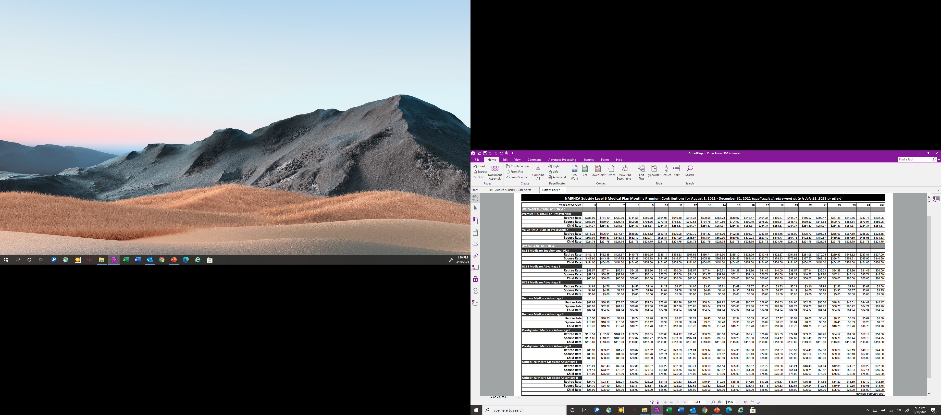
25-Year Rate Sheet

Slide 12
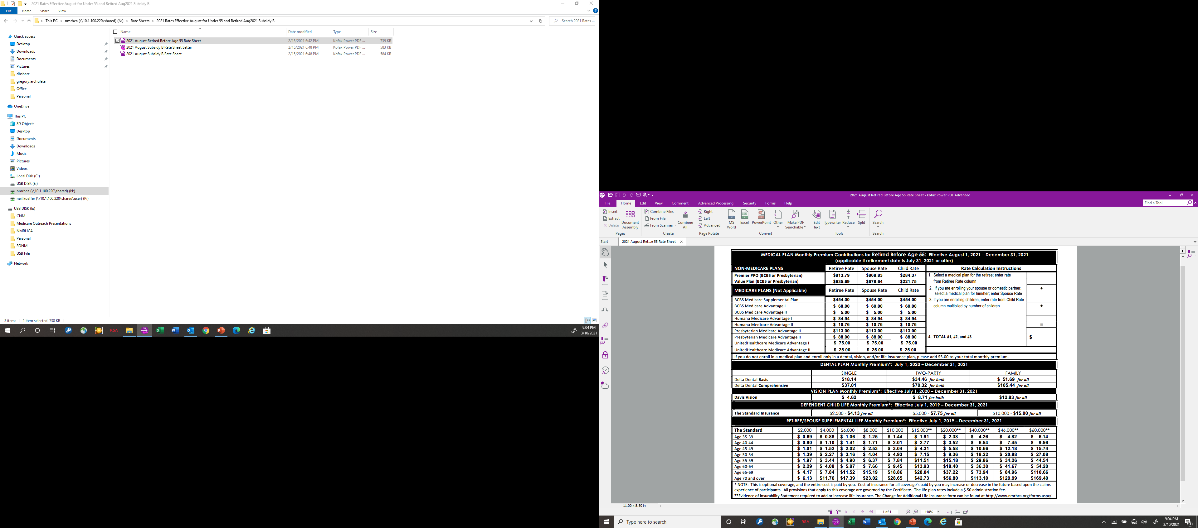
Non-Subsidized Amounts

Slide 13
Contact Information
*Offices currently closed to in-person visits*
Albuquerque
6300 Jefferson St. NE, Suite 150
Albuquerque, NM 87109
Santa Fe
33 Plaza La Prensa
Santa Fe, NM 87507
Toll free phone number: 1-800-233-2576
email: customerservice@state.nm.us
website: www.nmrhca.org

