Slide 1

The Joy
Of
Movement

Slide 2
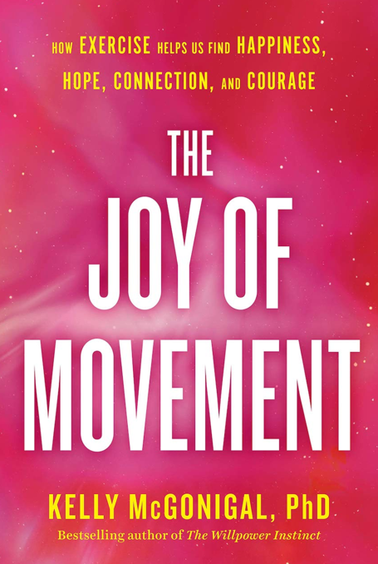
The Upside of Stress
The Science of Compassion
The Willpower Instinct
The Science of Flourishing

Slide 3
LIFE is The Hardest Sport You Will Ever Play
You must be fit to do hard things-Get Fit of Mind, Body & Spirit
Notes:
Truth: Most susceptible are health compromised: less fit, metabolic disease etc.

Slide 4
Self Care is Something We Can Control

Slide 5
The Best Investment You Can Make in Your Health is BE PREPARED
Be Fit of Body, Mind & Spirit
These things will put you in a better state to handle whatever life throws at you in these times.
Time to Double-Down on your Lifestyle Choices
Notes:
The behaviors we have around eating, stress exercise relationships make all the difference.

Slide 6

“Looking at the evidence it’s not hard to conclude that our entire physiology is designed to reward us for moving”
-Dr. Kelly McCoginal, Stanford University
Movement offers us pleasure, identity, belonging, and hope.
It puts us in places that are good for us, whether that’s outdoors in nature, in an environment that challenges us, or with a supportive community.
It allows us to redefine ourselves and reimagine what is possible.
It makes social connection easier and self-transcendence possible.

Slide 7
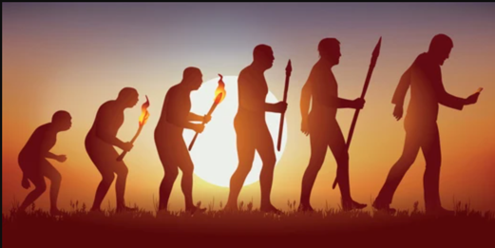
“Experiences that constantly violate evolution, undermine human nature”
Dr. Darcia Narvaes
University of Notre Dame

Slide 8
Harnessing Your Biology to Work for You
and
Not Against You
Modulating Through Biological Mechanisms

Slide 9
Bio-Reactor

Slide 10
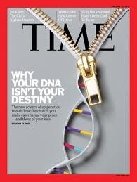
Epigenetics
January 2010

Slide 11
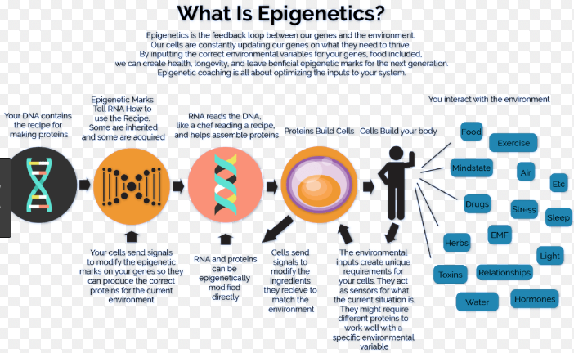

Slide 12
Exercise
Movement
Moving your body more often throughout the day-in whatever means that brings you more joy.

Slide 13
Happiness – Hope – Connection - Courage

Slide 14
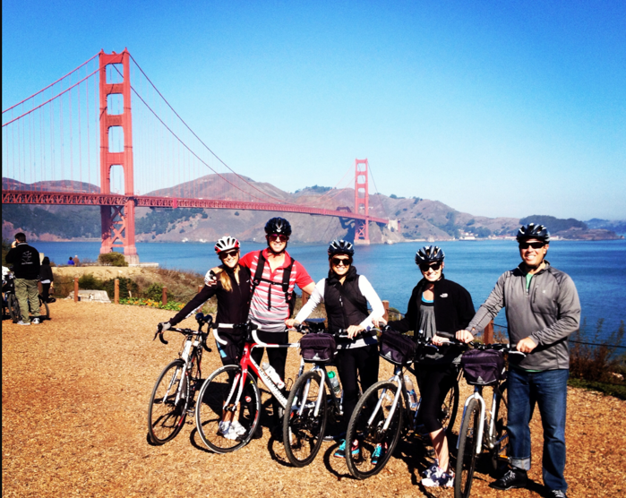
Sleep is the bridge between Hope & Despair

Slide 15
“Exercise is like taking a little bit of Riddelliine, and a little bit of Prozac in a perfect natural synergy”
John Ratey M.D., Harvard
Spark
Go Wild
“Not exercising is like taking a daily pill for depression”
- Tal-Ben Shahar Ph.D., Harvard
Being Happy
Choosing the life you want
Even Happier
The Joy of leadership

Slide 16

30 minutes of moderate to vigorous exercise was equally effective as SSRI in the first 6 months
500 times more effective post 6 months

Slide 17
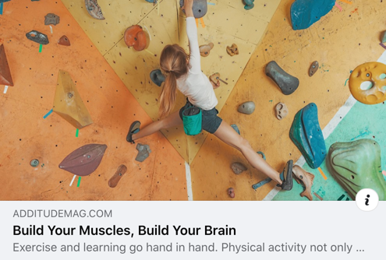
Protect Your Brain-Improve your capacity to Learn-Improve Memory
Notes:
By John Ratey-Steven Cotmans work on neuron & BDNF, Nobel prize winner on Neuro Plasticity at the Salk Institute (2000) HEBS Law-new neurons

Slide 18
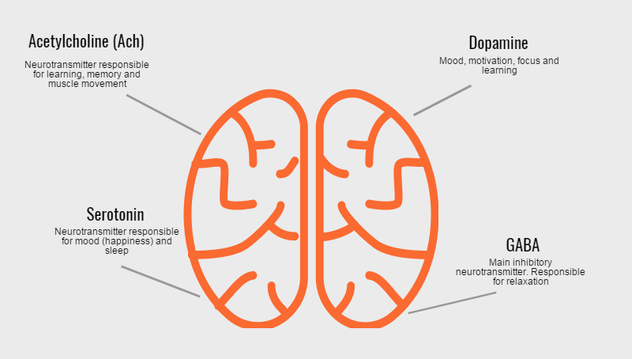
Movement is a Nootropic – SMART DRUG
Learning
Creativity
Cognitive Flexibility
Focus
Increased biology of learning

Slide 19
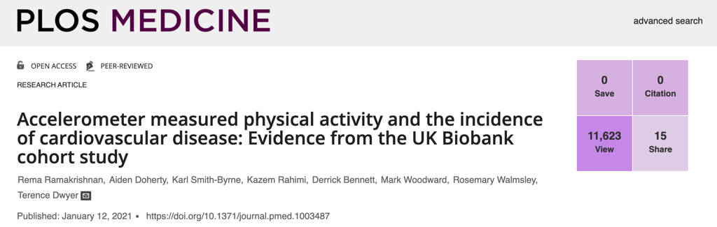
90,211 individuals ages 40-69 years old to wear an accelerometer
Tracked over 5 years
Top 25% of exercisers with highest volume of weekly exercise reduced their average risk by 48-57%.
Low group was around 10 min per week.
Good News is top exercisers Exercised 50 minutes per week on average.
Oxford University Study – January 2021

Slide 20

Those in the least active group were 2.5-fold more likely to die than those in the most active group
and 30 percent more likely to die than those in the moderately active group.
The only other risk factors for severe COVID-19 outcomes that had a greater impact than physical inactivity were advanced age and organ transplants.

Slide 21
Seek Discomfort

Slide 22
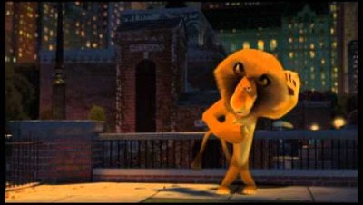
I Like To Move It….

Slide 23
Hope Molecules

Slide 24

“Runners High”
Endorphins
Anandamide
Dopamine
Serotonin
Mood, Alertness, Energy, Connection

Slide 25
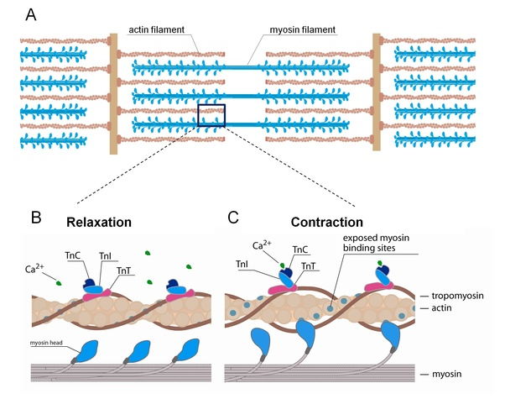
Even Our Muscles Are Wired For Rewarding Movement
Hope Molecules
When muscles contract they secrete hormones & proteins that makes your brain resistant to stress
Protects us

Slide 26
“The entire purpose of the human brain is to produce movement, movement is the only way we have of interacting with the world. Rewarding movement is how your brain and body encourage us to participate in life.”
-Dr. Daniel Wolpert
“If your willing to move your muscles will give you hope, your brain will orchestrate pleasure and your entire physiology will adjust to help you find the energy, purpose and courage to keep going.”

Slide 27
Hope Molecules

Slide 28
“Runners High”
Endorphins
Anandamide
Dopamine
Serotonin
Mood, Alertness, Energy, Connection

Slide 29
Even Our Muscles Are Wired For Rewarding Movement
Hope Molecules
When muscles contract they secrete hormones & proteins that makes your brain resistant to stress

Slide 30
Embodiment

Slide 31
5,649
4,774
Notes:
Greater risk for anxiety & depression

Slide 32
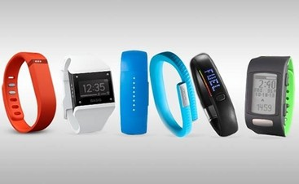
Activity Monitors = 1 mile more

Slide 33
Collective Effervescence

Slide 34


Slide 35
Entire brain is wired to reward physical activity-and to be with others

Slide 36
How We Endure

Slide 37
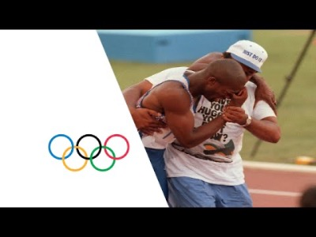
Connection & Courage

Slide 38


Slide 39
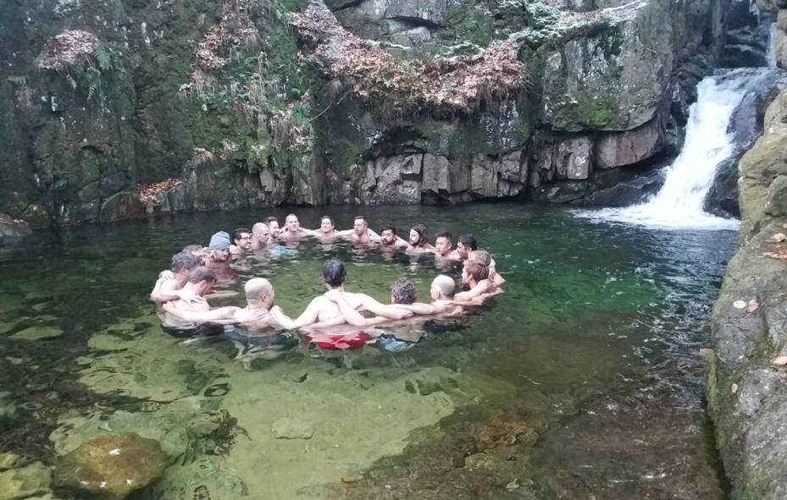
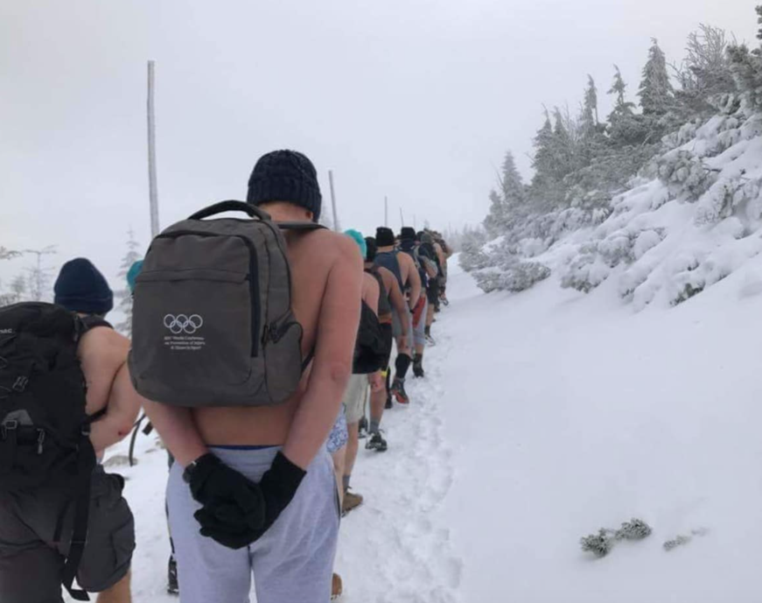
Shared Physical Challenges
Come together and support each other – We Transcend-We Become Greater
Teamwork Makes The Dream Work

Slide 40
“Rejecting exercise means rejecting significant experiences of being human.”

Slide 41
Overcoming Obstacles
Zest, Energy & Hope
Goal, Agency, Willingness to go through obstacles

Slide 42
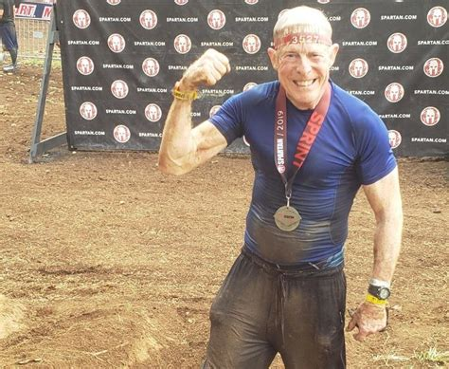


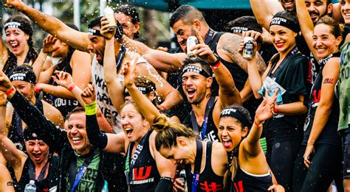
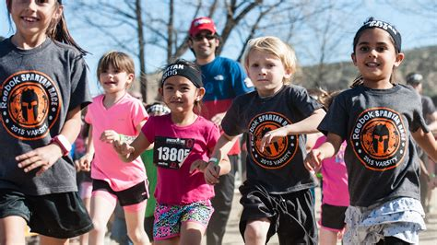
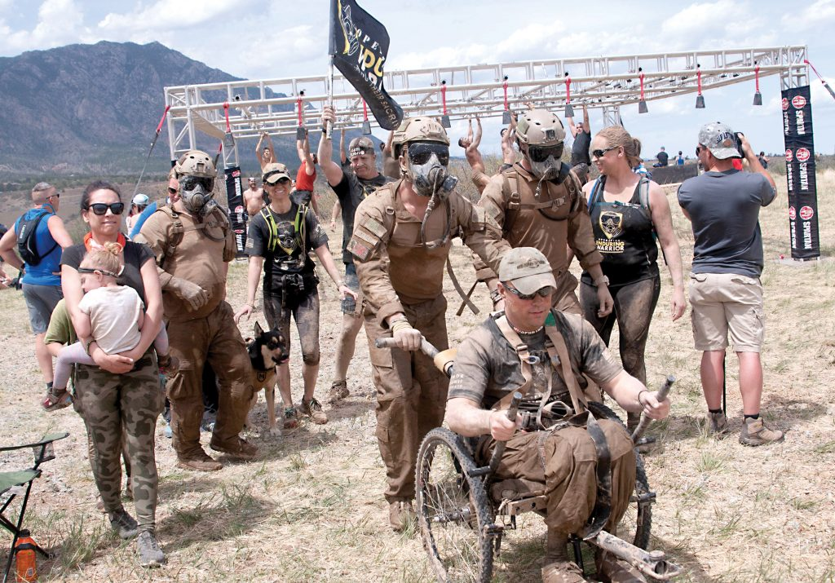
Seek Discomfort-Set Up

Slide 43
“It is not the critic who counts, not the one who points out how the strong man stumbled or how the doer of deeds might have done them better. The credit belongs to the man who is actually in the arena, whose face is marred with sweat and dust and blood; who strives valiantly; who errs and comes short again and again; who knows the great enthusiasms, the great devotions, and spends himself in a worthy cause; who, if he wins, knows the triumph of high achievement; and who, if he fails, at least fails while daring greatly, so that his place shall never be with those cold and timid souls who know neither victory nor defeat.”
-Teddy Roosevelt

Slide 44
Exercise
Movement
Moving your body more often throughout the day-in whatever means that brings you more joy.

Slide 45
Knowledge vs. Wisdom
It Must Be Experienced To Be Understood
Notes:
Taking action-think must turn into do

Slide 46
How little a thing can make us happy when we feel that we have earned it.
~ Mark Twain

